Slide 1
Muni University
BACHELOR OF INFORMATION SYSTEMS DEGREE
Year 3, Semester 2
Course Name: Data Warehousing and Business Intelligence
Course Code: ISM 3203
Samuel OCEN

Slide 2
Business Requirements Definition
Program versus project requirements preparation
Requirements gathering participants
Techniques for gathering requirements and handling obstacles
Program/project requirements deliverables
Requirements prioritization

Slide 3
Cont…
Successful implementation of DW/BI is greatly increased by understanding the business end users and their requirements
What are the business issues we are trying to address with the data warehouse?
What are the top business objectives of the organization? Validate with the top person - MD, line managers, whoever is in charge.
What information is needed by the decision makers.
Which issues need to be addressed first? (Have the business community rank the issues in order of importance - how much will addressing the particular issue contribute to the current objectives of the organization?)

Slide 4
Cont…
Business Requirements essentially help to compile
information packages for all the subjects of the DW/BI
Define common subject areas
Define key business metrics
Decide how much data must be presented
Decide how users will aggregate or roll-up
Decide data quantity for user analysis
Decide how data will be accessed
Establish data granularity
Estimate data warehouse size
Determine data refresh frequency
Ascertain how information must be packaged

Slide 5
Cont…
Information Package (Information Matrices)
Key Business Metrics/Facts
Business Dimensions
Dimension Hierarchies
Requirements Gathering Methods
Interviews
Group Sessions
Review of existing documentation
What business Requirements
Data Elements: Fact classes and Dimensions
Recording of data in terms of time
Data Extracts from source systems
Business Rules: Attributes, Ranges, Domains, Operational records

Slide 6
Cont…
Requirements Definition Document
Introduction
General Requirements descriptions
Specific Requirements
Information Packages
Other Requirements
User Expectations
User Participation and sign-off
General Implementation Plan

Slide 7
Program versus project requirements preparation
“Understanding of the requirements influence most life cycle choices, from establishing the right scope, modeling the right data, picking the right tools, applying the right transformation rules, building the right analyses, and providing the right deployment support”

Slide 8
Cont…
Project requirements analysis occurs in at two distinct levels:
Macro level; one needs to understand the business’ needs and priorities relative to a program perspective
This may be as broad as the entire enterprise, or simply across multiple projects.
Micro level; one needs to delve into the user’s needs and desires in the context of a single, relatively narrowly defined projects.

Slide 9
Cont…
For a new DW/BI initiative, one needs to make two passes during requirements gathering
High level program requirements
Low level program requirements
Generally, all requirements gathering initiative begin with a preparation phase, followed by interactive face-to-face elicitation meetings with the business, and concluded with documentation and determination of the next step.

Slide 10
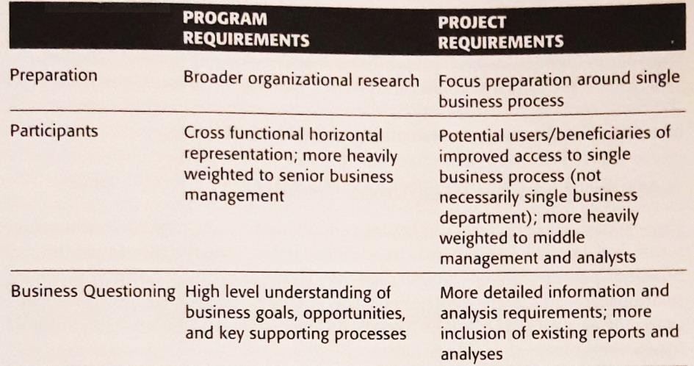
Cont…
Fig. 1: Differences between Program and Project Requirements Definition Efforts

Slide 11
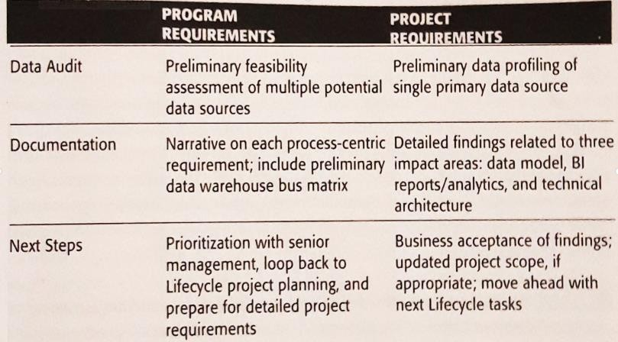
Cont…
Fig. 1: Differences between Program and Project Requirements Definition Efforts

Slide 12
Requirements gathering participants
Interview team:
Lead interviewer; responsible for directing the questioning.
The lead interviewer‘s relationship with interviewees and the business community should be taken into consideration.
The position requires the person to be open and honest.
Scribe; responsible for taking copious notes during the
interview, capturing as much interview content detail as
possible, regardless of whether it is news to them.
Observers; are an optional part of the interview team
These may include; modelers, DBAs, BI application developers, or technical support specialist.
The number of observers should be limited to a maximum of two observers.

Slide 13
Cont…
Interviewees;
Business interviewees; they include senior executive level, middle management, business analysts etc.
IT and compliance/ security interviewers; they include IT officers, compliance/ security officers etc.

Slide 14
Techniques for gathering requirements and handling obstacles
Techniques for gathering requirements
Interviews
Facilitated group Sessions
Face-to-face
Hybrid of interviews & facilitated group sessions
Review of existing documentation

Slide 15
Cont…
Techniques to avoid for gathering requirements
Sending out surveys or questionnaires
Reviewing the existing reports while excluding face-to-face sessions
Distribution of a list of data elements to the business.

Slide 16
Cont…
Obstacles and Techniques for handling obstacles
The are several common interviewing obstacles that one might run into during the business requirement gathering at either program or project level.
Abused user
This is uncooperative business representative who claims,
“we already told IT what we want”.
These users have been interviewed repeatedly in the past and not yet seen anything result from their effort.
They are frustrated by the historical false starts and may be refuse to meet with an interview team again.

Slide 17
Cont…
Solution to Abused user challenge
Proactively determine who was involved and interviewed in the earlier attempts at data warehousing and business intelligence.
Review any requirements documentation from the prior project.
When scheduling meeting with these abused users, it is helpful to acknowledge their participation in previous efforts and let them know you already reviewed the resulting documentation.
The new session should be presented as a validation rather than another back-to-the-beginning.
Consider choosing an alternative forum for gathering requirements.

Slide 18
Cont…
Overbooked / substitute user
These disengaged business users are simply too busy to meet anytime soon.
They may agree to a scheduled interview time, but then subsequently not show up or send a substitute in their place.
Solution:
An email from program sponsor to all the participants about importance to the initiative nips this disorder in the bud.
Consider replacing an | overbooked user | with a | more
cooperative business | partner elsewhere | within | your
organization.

Slide 19
Cont…
Comatose users
These business users respond to classic, open-ended questions with monosyllabic, one word responses.
Their responses are usually influenced by external causes.
These users are usually in the critical function or position within the organization.
Solution:
Direct their questions from a negative sense of what is inside the box.
Make several attempts to get the responses from them and in case of failure, consider replacing the user with the representative.

Slide 20
Cont…
Overzealous users
These are usually at the opposite end of the spectrum.
You think you are interviewing two business users, but seven people arrive in the designated conference room instead; the users are excited and want to be heard directly by the DW/BI team.
Solution:
Assess the homogeneity of the crowd
Cluster the users depending on their similarities and differences and give them separate time slots on the interview schedule. This ensues adequate time for each meeting ng to gather the details you need.

Slide 21
Cont…
Know-it-All users
These folks sit between IT and the real ultimate business users & they are sometimes IT wannabes.
They sometimes act as gatekeepers, rationalizing that there’s no need to bother the other business folks for their requirements when they already have a through understanding and can represent their needs.
Solution:
Engage the know-it-All users & even elevate their perceived role and importance all so long as their dependence is regulated.

Slide 22
Cont…
Clueless users
These don’t get it, they may not be able to articulate precisely which data elements in which source systems interest them, but nearly all the time, they can clearly describe what they do, why, and what they want to be doing in the future.
Solution:
The IT professionals should translate the info from clueless users into data and functional specifications for the DW/BI system.

Slide 23
Cont…
Nonexistent users
This is a fatal to a DW/BI initiative.
This condition results when members of IT organization say they know what the business users need, & sometimes purport to be knowing more than what the business users know.
These are IT organizations that attempt to model their data warehouse based on source data layouts exclusively and then don’t understand why business users aren’t clamoring to use data warehouse.
Solution:
This obstacle is totally within the ability of IT organization to deal with.

Slide 24
Program/project requirements deliverables
It is essential to write down the information gathered
Documentation acts an encyclopedia of reference material as resources are added to the DW/BI team.
Critical information may be lost if people roll off the team without documenting their findings.
Documentation helps the team crystalize and better understand the interview content.
Documentation helps to validate the findings with users. It closes the loop with the users by confirming that what they said was accurately documented.
Key deliverables for collecting the requirements include:
Interview questionnaire
Business user kickoff meeting agenda
Pre-interview briefing letter for the interviewees
Program and/or project interview write-ups
Program requirements findings document, including the preliminary enterprise data warehouse bus matrix and agreed-upon prioritization grid.

Slide 25
Requirements prioritization
One of the favorite techniques for prioritizing individual projects within the overall program is the prioritization grid.
In this setting, gather approx. 10-12 executive representatives, preferably from among those who have participated in the requirements process.
The review and prioritization begins with a presentation of the business requirements findings.
The requirements are presented with a slide or two for each business process, describing what it refers to, core metrics, perceived business value and/or support for key initiatives, and relative assessment feasibility.
Present a simplified version of the data warehouse bus architecture matrix
for participants.
Use the opportunity matrix to further reinforce the commonality of needs.

Slide 26
Cont…
Once everyone is on the same page regarding the organization’s program requirements, pull out the two-by-two prioritization grid as shown in Fig. 2.

Slide 27
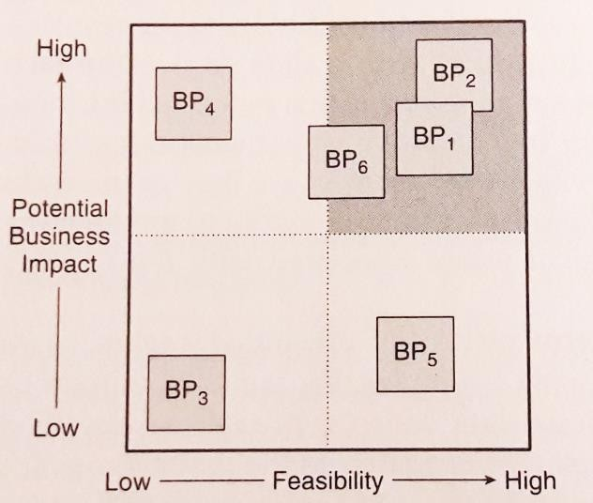
Cont…
Fig 2: Prioritization Grid

Slide 28
Thank you!
End

